Slide 1

GFATM TB Grants in Romania
Romanian Angel Appeal Foundation

Slide 2
Implementation period:
01.10.2007 – 31.03. 2015
Geographic coverage: National
Grant:
ROM-607-G04T_TFM_NCE

Slide 3
Goal and objectives
Goal: To reduce the burden of TB in Romania
Objectives:
  Provide high-quality TB diagnosis and patient-centered care through training of public and private sector provide
  Protect poor and vulnerable populations from TB through targeted education and adherence interventions
  Scale up MDR-TB control by implementation of DOTS Plus
  Expand capacity of the NTP to manage and coordinate national and local TB control activities through health systems strengthening
  Develop community support and political commitment for TB control
  Ensure the efficient and effective implementation of the Global Fund grant

Slide 4
Implementing Partners and Results
Sub-recipients
  Institutul de Pneumoftiziologie Prof. Dr. Marius Nasta
  Administratia Nationala a Penitenciarelor
  Centrul pentru Politici si Servicii de Sanatate
  Organizatia Salvati Copiii
  Scoala Nationala de Sanatate Publica si Mangement Sanitar
  Centrul National de Studii pentru Medicina Familiei
  Crucea Rosie Romana
  Uniunea Nationala a Organizatiilor Persoanelor Afectate de HIV/SIDA (UNOPA)
Sub-sub recipient:
  Asociatia pentru Sprijinirea Pacientilor cu Tuberculoza Multidrog Rezistenta (ASPTMR)

Slide 5
Implementing Partners and Results

Slide 6
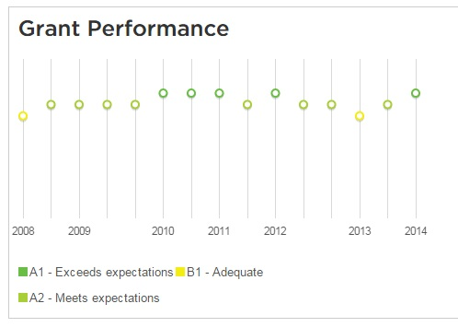
Source: http://portfolio.theglobalfund.org/en/Grant/Index/ROM-607-G04-T

Slide 7
Financial
Funds and expenditures (October 2007- March 2015) | EURO
Budget contracted with GFATM | 10,510,257
Disbursment GFATM | 10,509,413
VAT recovered | 667,058
Interest | 35,382
Expenditures 31.03.2015 | 11,125,678
Committed expenditures | 80,720
Not committed (savings) | 5,455

Slide 8
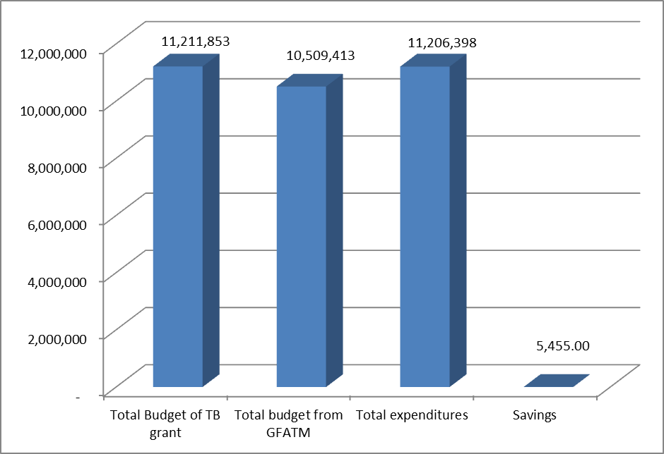
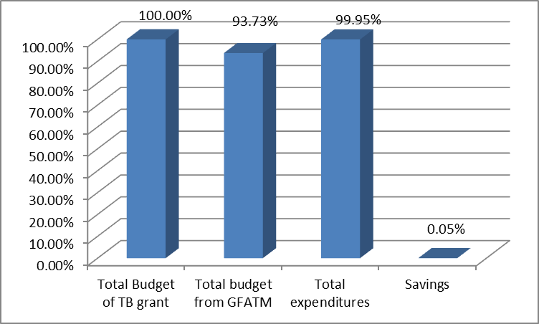

Slide 9
IMPLEMENTATION PERIOD:
01.04.2015 – 31.03.2018
Geographic coverage: national
GRANT: ROU-T-RAA

Slide 10
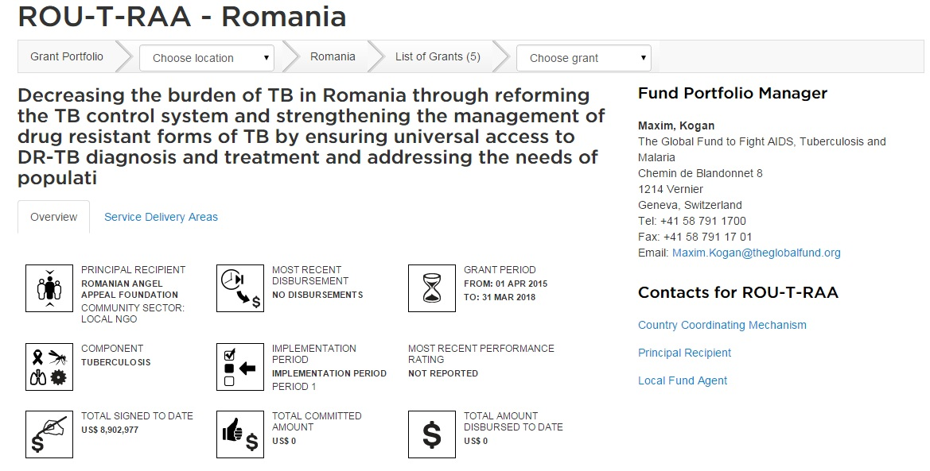
GRANT OVERVIEW
Source: http://portfolio.theglobalfund.org/en/Grant/Index/ROU-T-RAA

Slide 11
Implementation map

Slide 13
Main expected results
Development of the ambulatory care reform (including revision of the financial mechanisms, development of the community workers network, etc)
Implementation of the ambulatory care reform in 6 counties
Update of the national guidelines re. TB/HIV, case management of TB in children, diagnostic
Centralised procurement for drugs and diagnostic consumables

Slide 14
Main expected results (cont.)
Indicators and targets are set in accordance with the National Strategy for TB control in Romania
The indicators are not set to reflect the performance of the activities implemented under the grant, but the impact of the National TB Programme (TB incidence, prevalence, treatment success rate for TB and MDR TB, mortality rate, etc)

Slide 15
Additional PR responsibilities
Management of the development and implementation of the ambulatory care reform (including the cost analysis study)
Management of all TA missions international and national
Centralised procurement and SCM: drugs, diagnostic consumables and equipment, health products (syringes, needles, condoms, HIV, Hep B and C tests, vaccines, etc), vouchers, HEPA masks, etc

Slide 16
Status at 27 April 2015
Sub-grant agreements signed
Operational manual revised and distributed to SRs
First training and working meeting with SRs planned for 7th May
All disbursements to SRs will be operated as soon as RAA will receive the first disbursement from the GF

